Slide 1
Green Algae and Land Plants
0

Slide 2
Chapter 28 Opening Roadmap.
© 2017 Pearson Education, Ltd.
Notes:
Chapter 28 Opening Roadmap.

Slide 3
Introduction
The Viridiplantae, or green plants, consist of the green algae and land plants
Green algae are important photosynthetic organisms in freshwater habitats
Land plants are the key photosynthesizers in terrestrial environments

Slide 4
Introduction
Green algae have traditionally been considered protists, but we study them along with land plants for two reasons:
They are the closest living relatives to land plants
The transition from aquatic to terrestrial life occurred when land plants evolved from green algae

Slide 5
Introduction
Land plants were the first organisms that could thrive with their tissues completely exposed to the air
Before land plants evolved, terrestrial life was limited to bacteria, archaea, and single-celled protists
Plants transformed the nature of life on Earth

Slide 6
Why Do Biologists Study Green Plants?
Biologists study plants not only because they are fascinating organisms but also because we could not live without them
People rely on plants for food, fuel, the fibers used to make clothing and other products, building materials, and pharmaceuticals
Agriculture, forestry, and horticulture are among the most important industries based on plants

Slide 7
Why Do Biologists Study Green Plants?
Biologists also study plants that cause problems for humans:
Weeds that decrease crop productivity
Newly introduced species that invade and then degrade natural areas

Slide 8
Plants Provide Ecosystem Services
An ecosystem consists of
All of the organisms in a particular area
Nonliving physical components of the environment, such as
The atmosphere
Precipitation
Surface water
Sunlight
Soil
Nutrients

Slide 9
Plants Provide Ecosystem Services
Ecosystem services provided by green algae and land plants include
Producing oxygen via oxygenic photosynthesis
Building soil by providing food for decomposers
Holding soil and preventing nutrients from being lost to wind or water erosion
Holding water in the soil
Moderating the local climate by providing shade and reducing the impact of wind on landscapes

Slide 10
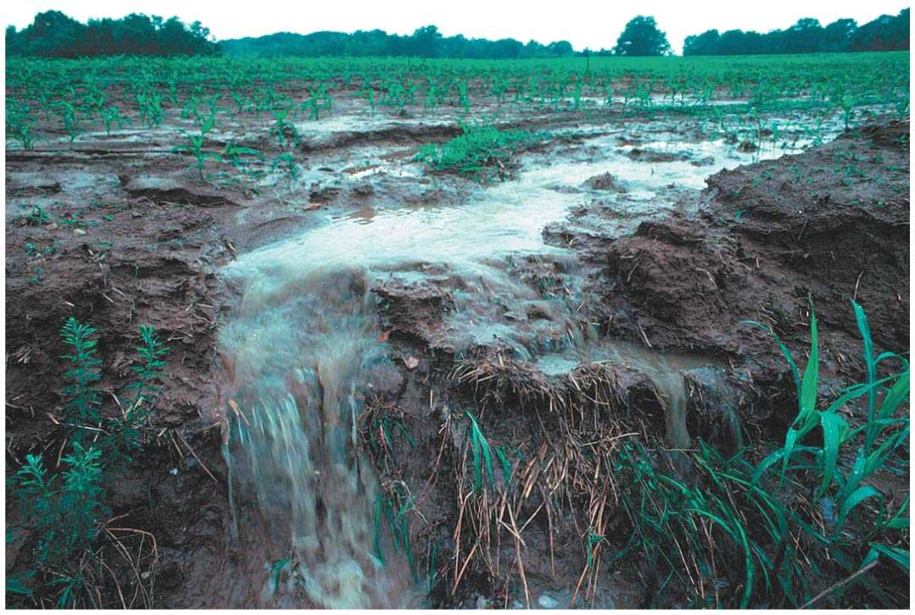
Figure 28.1
© 2017 Pearson Education, Ltd.
Notes:
Figure 28.1 Devegetation Leads to Erosion.

Slide 11
Plants Are Primary Producers
Land plants are the dominant primary producers in terrestrial ecosystems
They convert energy in sunlight into chemical energy
The sugars produced by land plants support virtually all other organisms in terrestrial habitats

Slide 12
Plants Are Primary Producers
Land plants are the key to the carbon cycle
Take CO₂ from the atmosphere and reduce it to make sugars
Fix much more CO₂ than they release
The loss of plant-rich prairies has contributed to increased concentrations of CO₂ in the atmosphere
Partly responsible for rising temperatures associated with global climate change

Slide 13
Plants Provide Humans with Food, Fuel, Fiber, Building Materials, and Medicines
Food
Agricultural research began with the initial domestication of crop plants
Artificial selection for plants with certain properties has led to dramatic changes in plant characteristics

Slide 14
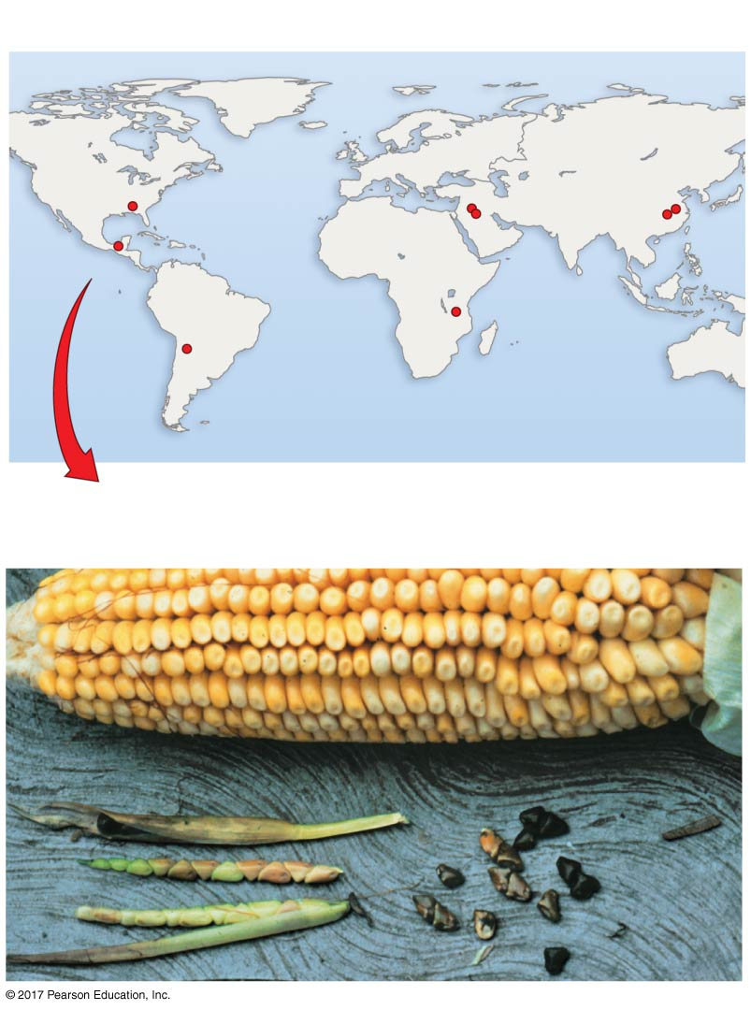
Figure 28.2
(a) Plants were domesticated at an array of locations.
Wheat
Rice
Sunflower
Barley
Soybeans
Maize
Potato
Millet
(b) Artificial selection changes the traits of
domesticated species.
Domestic maize
Wild maize (teosinte)
© 2017 Pearson Education, Ltd.
Notes:
Figure 28.2 Crop Plants Are Derived from Wild Species via Artificial Selection.

Slide 15
Plants Provide Humans with Food, Fuel, Fiber, Building Materials, and Medicines
Fuel
Historically, humans relied on wood burning for energy
In industrialized countries, fossil fuels including coal and petroleum or natural gas have replaced wood
Fossil fuels are derived from plants—living or long-deceased

Slide 16
Plants Provide Humans with Food, Fuel, Fiber, Building Materials, and Medicines
Fiber and Building Materials
Plants provide us with important sources of raw material for clothing, rope, and household articles such as towels and linens
Woody plants provide
Lumber for houses and furniture
Fibers used to make paper

Slide 17
Plants Provide Humans with Food, Fuel, Fiber, Building Materials, and Medicines
Medicines
About 25% of the prescriptions written in the United States each year include at least one molecule derived from plants
Most of these compounds are synthesized by plants to repel herbivores

Slide 18
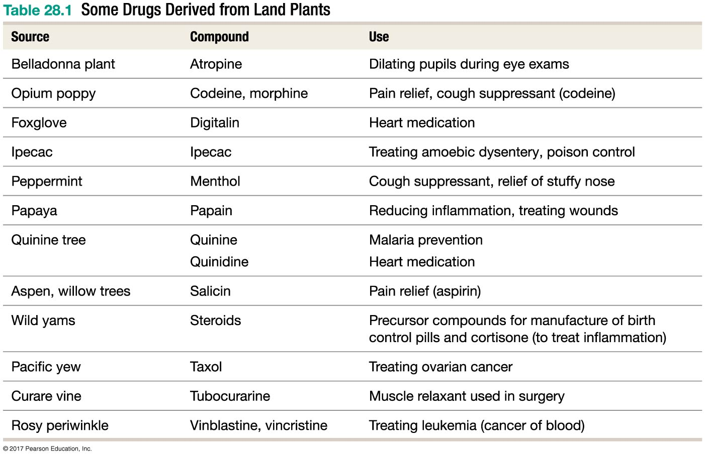
Table 28.1
© 2017 Pearson Education, Ltd.
Notes:
Table 28.1 Some Drugs Derived from Land Plants.

Slide 19
How Do Biologists Study Green Algae and Land Plants ?
To understand diversification:
Compare morphological traits
Analyze the fossil record
Estimate phylogenetic trees

Slide 20
Analyzing Morphological Traits
The green algae include species that
Are unicellular, colonial, or multicellular
Live in marine, freshwater, or moist terrestrial habitats
The vast majority of green algae are aquatic
The vast majority of land plants are terrestrial

Slide 21
Similarities between Green Algae and Land Plants
Biologists have long hypothesized that green algae are closely related to plants on the basis of several key traits:
Their chloroplast structure is the same
Their thylakoid arrangements are similar
Their cell walls, sperm, and peroxisomes are similar in structure and composition
Their chloroplasts synthesize starch as a storage product

Slide 22
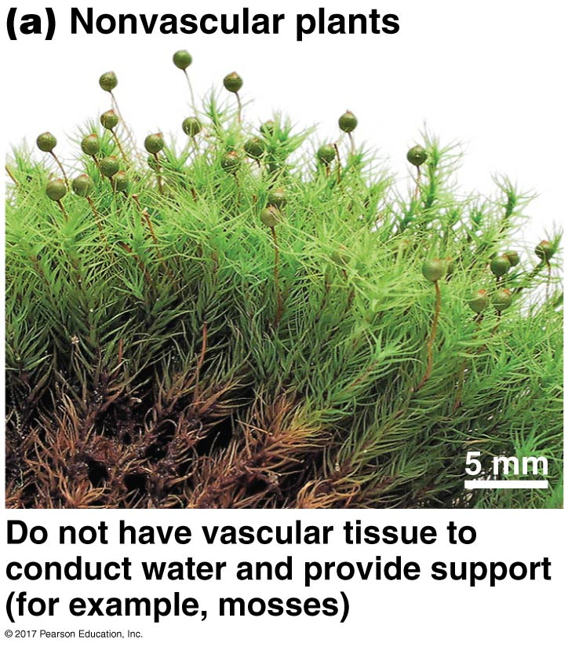
Major Morphological Differences among Land Plants
​Nonvascular plants
Lack vascular tissue
Specialized groups of cells that conduct water or dissolved nutrients throughout the plant body
Include mosses
Use spores, not seeds, for reproduction and dispersal
Notes:
Figure 28.4a Morphological Diversity in Land Plants.

Slide 23
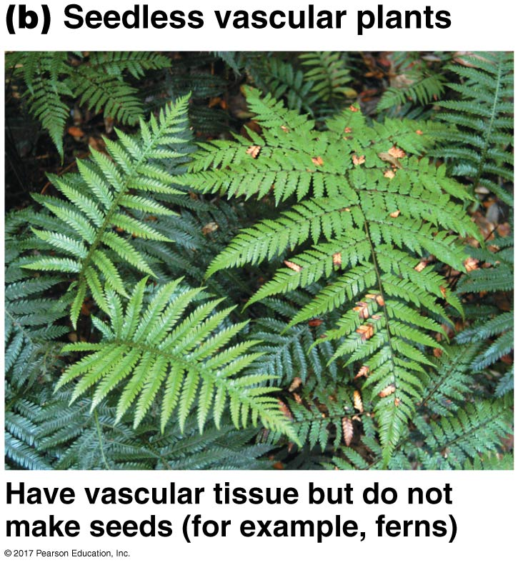
Major Morphological Differences among Land Plants
​Seedless vascular plants
Have well-developed vascular tissue
Do not make seeds; use spores for reproduction
Includes ferns
Notes:
Figure 28.4b Morphological Diversity in Land Plants.

Slide 24
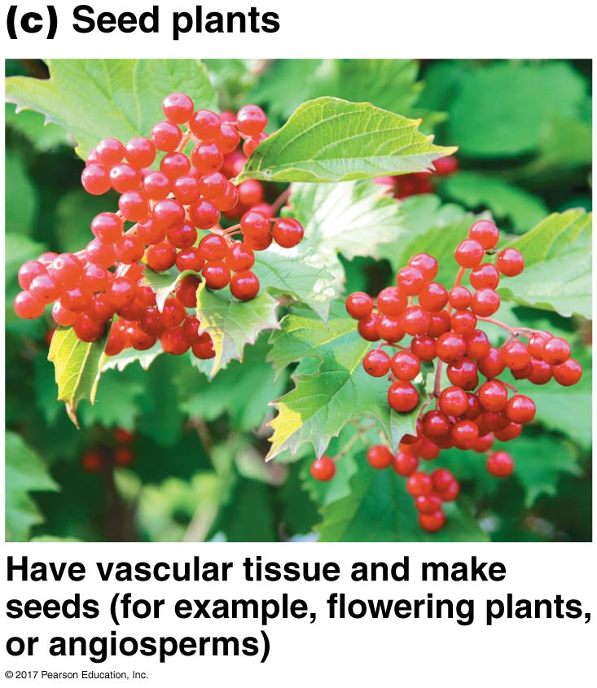
Major Morphological Differences among Land Plants
​Seed plants
Have vascular tissue
Make seeds
Seeds consist of an embryo and a store of nutritive tissue, surrounded by a tough protective layer
Include angiosperms (“encased-seeds”), or flowering plants and gymnosperms (“naked seeds’)
Notes:
Figure 28.4c Morphological Diversity in Land Plants.

Slide 25
Preventing Water Loss: Cuticle and Stomata
Cuticle is a watertight sealant that covers the aboveground parts of the plant and gives them the ability to survive in dry environments
However, cuticle also keeps CO₂ out of plant
Most plants solve this problem with stoma (“mouth”; plural: stomata) that consists of an opening surrounded by specialized guard cells
Pore opens and closes as guard cells change shape
Gas exchange accomplished through pore

Slide 26
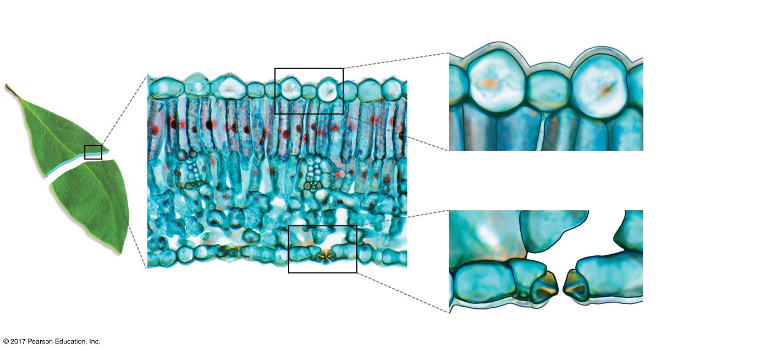
Figure 28.7
(a) Cuticle is a waxy layer that prevents
water loss from stems and leaves.
Leaf cross section
Cuticle
Moist
photosynthetic
cells
(b) Stomata have pores that allow gas
exchange in photosynthetic tissues.
Pore
25 µm
Guard cell
Cuticle
Stoma
© 2017 Pearson Education, Ltd.
Notes:
Figure 28.7 Cuticle and Stomata Are the Most Fundamental Plant Adaptations to Life on Land.

Slide 27
Providing Protection from UV Irradiation
Plants out of water exposed to harmful UV rays of the sun
UV light damages DNA by causing thymine dimers
Water absorbs UV light, so algae did not face this problem to the same extent

Slide 28
Providing Protection from UV Irradiation
Many species of algae probably colonized wet soil near home ponds, but only some were able to survive the harsh sunlight
The plants that survived were those that by chance made compounds that absorb UV light
Most plants today accumulate UV-absorbing compounds (flavonoids) that protect DNA from damage

Slide 29
The Importance of Upright Growth
First land plants were small or had a low, sprawling growth habit
Had to grow in a way that kept many or most of their tissues in direct contact with moist soil
Competition for space and light would have become intense soon after the first plants began growing on land
In a terrestrial environment, individuals that can grow upright have much better access to sunlight than individuals that cannot

Slide 30
Elaboration of Vascular Tissue: Tracheids and Vessels
Simple water-conducting tissues evolved by natural selection into more complex, efficient supportive and water-conducting tissues
Long, thin, tapering, water-conducting cells called tracheids evolved about 380 mya

Slide 31
Elaboration of Vascular Tissue: Tracheids and Vessels
Tracheids have
A thickened, lignin-containing secondary cell wall in addition to a cellulose-based primary cell wall
Pits in the sides and ends of the cell, which allow water to flow efficiently between tracheids
The secondary cell wall increased structural support, but water could still move easily through the cells because of the pits
Today, all vascular plants contain tracheids

Slide 32
Elaboration of Vascular Tissue: Tracheids and Vessels
Vessel elements, the most specialized type of water-conducting cell, appeared about 250 to 270 mya
Vessel elements
Are shorter and wider than tracheids
Have gaps on both ends where both cell walls are missing
In stems and branches of some vascular plants, tracheids or a combination of tracheids and vessels form wood
Strong support material

Slide 33
Mapping Evolutionary Changes on the Phylogenetic Tree
Cuticle, stomata, and vascular tissue were key adaptations that allowed early plants to colonize land
Fundamental adaptations to dry conditions—such as cuticle, pores, stomata, vascular tissue, and tracheids—evolved just once
Convergent evolution also occurred, as vessels evolved independently in angiosperms, gnetophytes, and several species of seedless vascular plants

Slide 34
How Do Plants Reproduce in Dry Conditions?
Life cycles of sexually reproducing eukaryotes serve several functions:
Increasing genetic variability due to meiosis and fertilization
Increasing the number of individuals
Dispersing individuals to new habitats

Slide 35
How Do Plants Reproduce in Dry Conditions?
Three innovations were instrumental for efficient plant reproduction in a dry environment:
Spores that resist drying because they are encased in a tough coat of sporopollenin
Gametes that were produced in complex, multicellular structures (gametangia: archegonie and antheridia)
Embryos that were retained on and nourished by the parent plant

Slide 36
Desiccation-Resistant Spores
Spores resist drying because they are encased in a tough coat of sporopollenin
Tough outer coating of spores helps them survive for fairly long periods of time
Can be dispersed hundreds of miles by wind currents
Resistant, lightweight nature of spores helps increase their chances of being dispersed to a suitable environment for growth

Slide 37
Protective, Complex Reproductive Organs
Individuals produce distinctive male and female gametangia
Antheridium (plural: antheridia)—sperm-producing
Archegonium (plural: archegonia)—egg-producing
Analogous to the testes and ovaries of animals

Slide 38
Figure 28.10
Male
Moss gametophytes are either
male or female
Female
Antheridia
(containing sperm)
Eggs
0.2 mm
Archegonia
0.2 mm
© 2017 Pearson Education, Ltd.
Notes:
Figure 28.10 In All Land Plant Groups except Angiosperms, Gametes Are Produced in Gametangia.

Slide 39
Embryos Nourished by Parental Tissues
Instead of shedding their eggs into the water or soil, as did their ancestors, land plants retain them
Eggs form inside archegonia
In contrast to most green algae, zygotes of land plants
Begin development on the parent plant
Form multicellular embryos that remain attached to and can be nourished by the parent plant

Slide 40
Embryos Nourished by Parental Tissues
The retention of the embryo was a key event in land plant evolution
The group’s formal name is Embryophyta, literally, the “embryo-plants”
The retention of the fertilized egg in embryophytes is analogous to pregnancy in mammals

Slide 41
Alternation of Generations
All land plants undergo alternation of generations, in which individuals have
A multicellular haploid phase called the gametophyte
A multicellular diploid phase known as the sporophyte
The two phases of the life cycle are connected by distinct types of reproductive cells—gametes and spores

Slide 42
Alternation of Generations
Alternation of generations does not occur in the algal groups most closely related to land plants

Slide 43
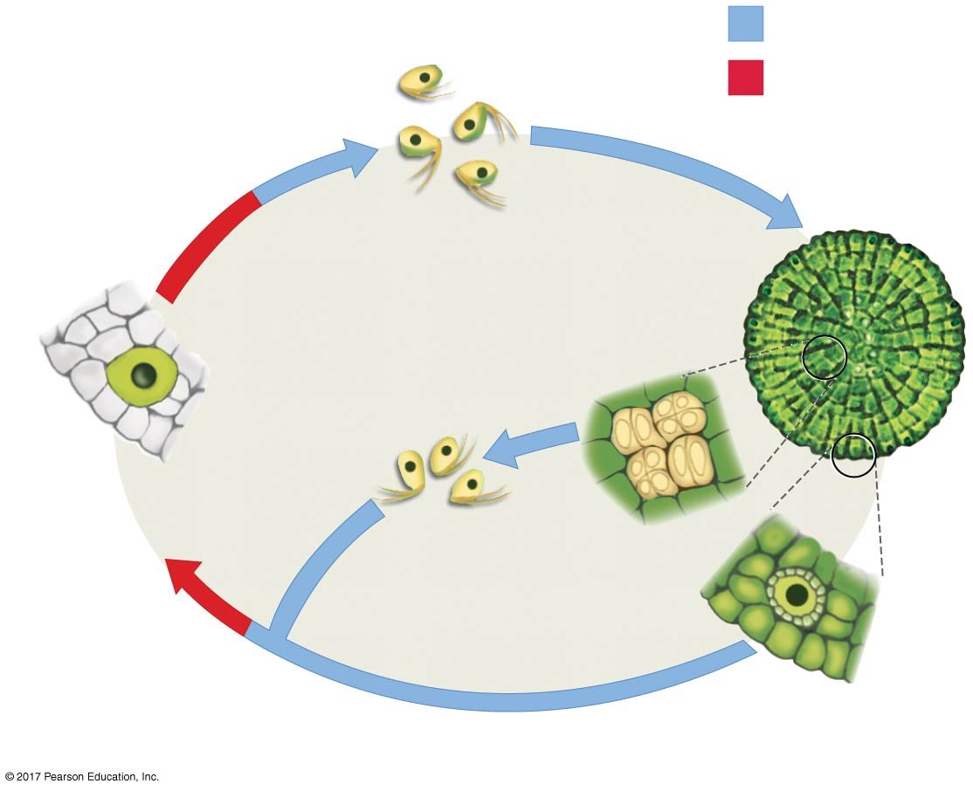
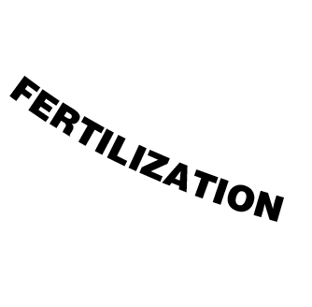
Figure 28.11
Haploid (n)
Diploid (2n)
Spores (n)
Multicellular
adult (n)
Zygote (2n)
(retained on
parent)
Sperm (n)
Gametes are
produced in
gametangia
Egg (n)
© 2017 Pearson Education, Ltd.
Notes:
Figure 28.11 In Green Algae That Are Closely Related to Land Plants, Only the Zygote Is Diploid.

Slide 44
Alternation of Generations
Alternation of generations always involves the same sequence of events:
The sporophyte produces haploid spores by meiosis
Spores germinate and divide by mitosis and develop into multicellular, haploid gametophytes
Gametophytes produce unicellular haploid gametes by mitosis
Two gametes unite during fertilization to form a diploid zygote
The zygote divides by mitosis and develops into a multicellular, diploid sporophyte

Slide 45
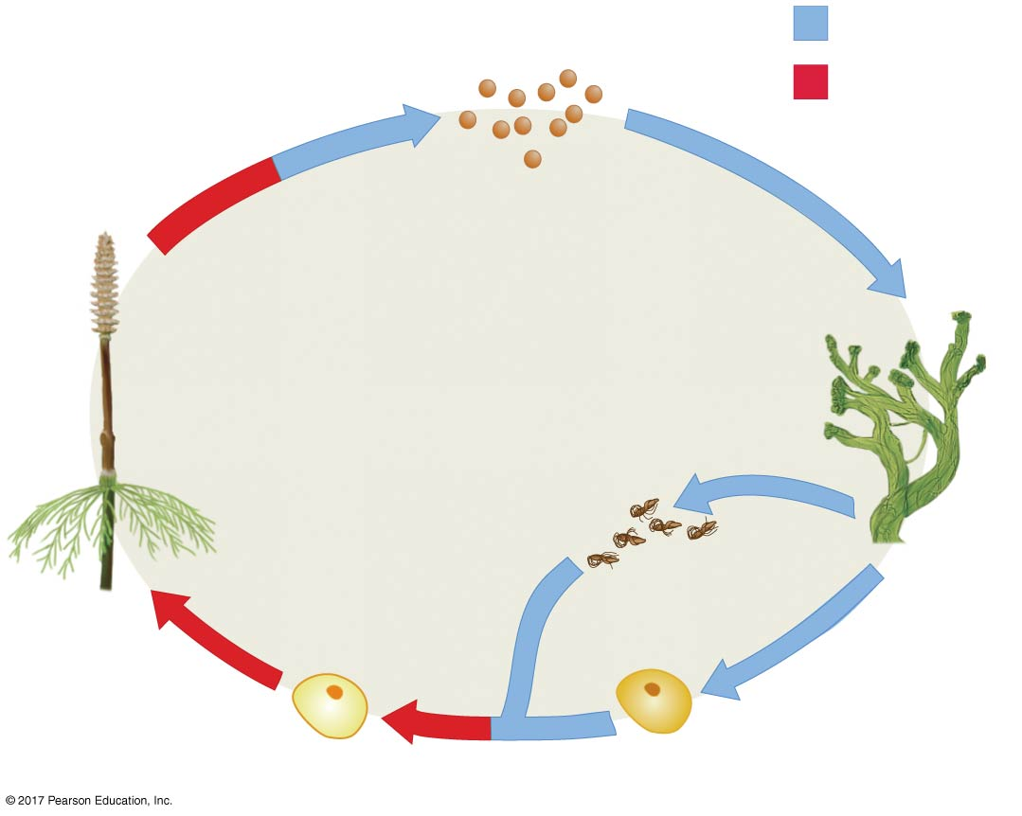
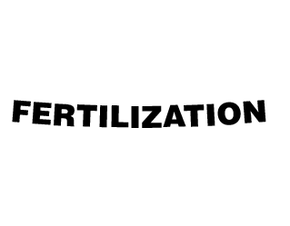
Figure 28.12
Haploid (n)
Diploid (2n)
1
2
Spores (n)
Gametophyte
(multicellular,
haploid)
Sporophyte
(multicellular,
diploid)
(2n)
MITO
(n)
SIS
3
Zygote
(2n)
Gametes
(n)
5
3
4
© 2017 Pearson Education, Ltd.
Notes:
Figure 28.12 All Land Plants Undergo Alternation of Generations.

Slide 46
Alternation of Generations
Compare and contrast zygotes, spores, and gametes:
Zygotes and spores are both single cells that divide by mitosis to form a multicellular individual. Zygotes develop into sporophytes; spores develop into gametophytes
Zygotes are diploid and spores and gametes are haploid
Zygotes result from the fusion of two haploid cells, such as a sperm and an egg, but spores are not formed by the fusion of gametes
Spores are produced by meiosis inside structures called sporangia; gametes are produced by mitosis inside gametangia

Slide 47
From Gametophyte-Dominant to Sporophyte-Dominant
In nonvascular plants, sporophyte is small and short lived and is largely dependent on gametophyte for nutrition
Gametophyte-dominant life cycle
In ferns and other vascular plants, sporophyte is much larger and longer lived than gametophyte
Sporophyte-dominant life cycle
Gametophytes of gymnosperms and angiosperms are microscopic

Slide 48
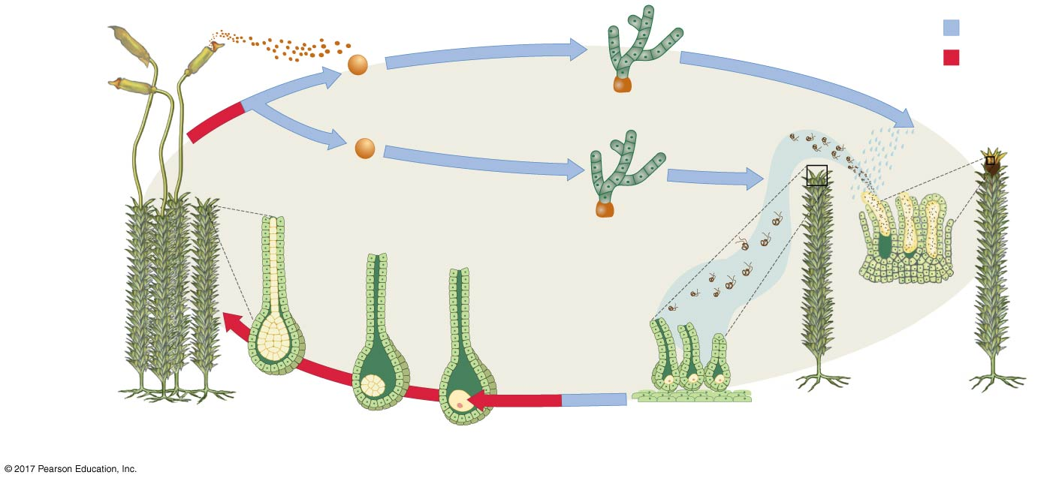
Figure 28.13
Haploid (n)
Diploid (2n)
Mature
sporophyte
(2n)
Spores dispersed
by wind (n)
Developing
gametophytes (n)
Sperm
swim to
egg
Developing
sporophyte
(2n)
Mature female
gametophyte
(n)
Sperm
develop in
antheridia
2 µm
Zygote
Egg
(n)
(2n)
2 µm
FERTILIZATION
Eggs develop
in archegonia
Mature female
gametophyte
(n)
Mature male
gametophyte
(n)
Archegonium
© 2017 Pearson Education, Ltd.
Notes:
Figure 28.13 Gametophyte-Dominant Life Cycles Evolved Early.

Slide 49
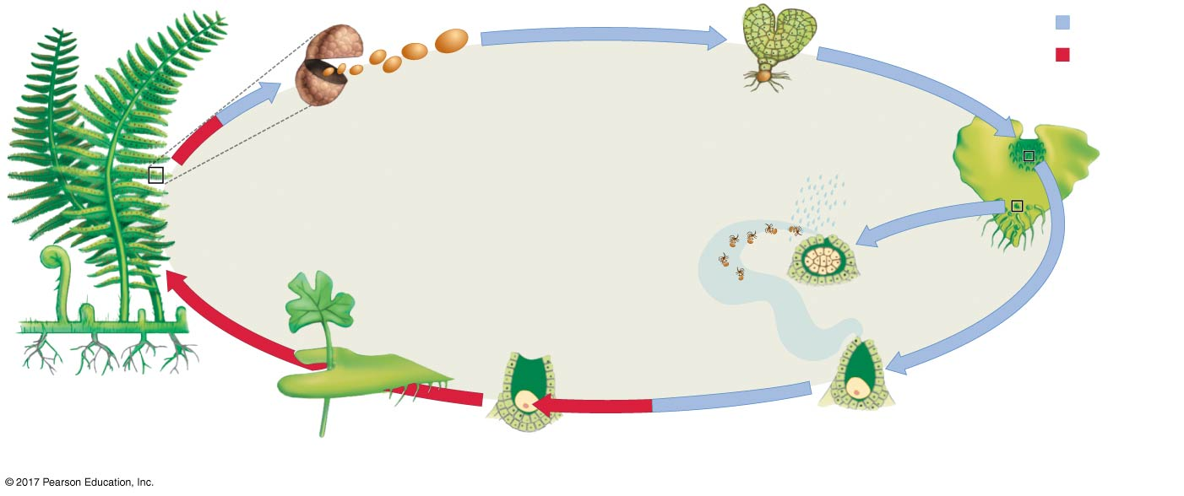
Figure 28.14
Haploid (n)
Diploid (2n)
Spores
dispersed
by wind (n)
Developing
gametophyte (n)
Spores are
produced in
sporangia
1 mm
Mature
gametophyte
(n)
Sporophyte
(2n)
Sperm (n)
develop
in antheridia
Zygote
Sperm
swim to egg
(2n)
Mature
sporophyte (2n)
Egg (n)
Gametophyte
(n; side view)
Eggs develop
in archegonia
Archegonium
© 2017 Pearson Education, Ltd.
Notes:
Figure 28.14 Sporophyte-Dominant Life Cycles Evolved Later.

Slide 50
From Gametophyte-Dominant to Sporophyte-Dominant
The transition from gametophyte-dominated life cycles to sporophyte-dominated life cycles is striking
Sporophyte-dominated life cycles were advantageous
Diploid cells can respond to varying environmental conditions more efficiently than haploid cells can
This is especially true if the individual is heterozygous at many genes

Slide 51
Heterospory
Heterospory—production of two distinct types of spores by different structures
All of the nonvascular plants and most of the seedless vascular plants are homosporous
Produce a single type of spore
Spores develop into bisexual gametophyte that produces both eggs and sperm
These gametophytes can self-fertilize and produce offspring

Slide 52
Figure 28.16a
(a) Nonvascular plants and most seedless vascular plants
are homosporous.
© 2017 Pearson Education, Ltd.
Notes:
Figure 28.16a Homospory versus Heterospory.

Slide 53
Heterospory
The two types of spore-producing structures in heterosporous species are microsporangia and megasporangia
Microsporangia produce microspores that develop into male gametophytes, which produce small gametes called sperm
Megasporangia produce megaspores that develop into female gametophytes, which produce large gametes called eggs
The gametophytes of seed plants are either male or female, but never both

Slide 54
Figure 28.16b
(b) Seed plants are heterosporous.
© 2017 Pearson Education, Ltd.
Notes:
Figure 28.16b Homospory versus Heterospory.

Slide 55
Pollen
Sperm of the nonvascular and seedless vascular plants have to swim to the egg to fertilize it
Water must be available for fertilization to occur
Pollen grain in land plants allowed plants living in dry habitats to reproduce efficiently
Tiny male gametophytes surrounded by a tough coat of sporopollenin
Can be exposed to air for long periods of time without drying out
Carried to female gametophyte by wind or animals

Slide 56
Seeds
The evolution of embryo retention had a downside:
In ferns and horsetails, sporophytes have to live in the same place as their parent gametophyte
Seed plants overcome this limitation
Embryos of seed plants are portable and can disperse to new locations

Slide 57
Seeds
A seed is a structure that includes an embryo and a store of nutrients provided by the mother and surrounded by a tough, protective coat
Spores are an effective dispersal stage for nonvascular plants and seedless vascular plants, but they lack the stored nutrients found in seeds

Slide 58
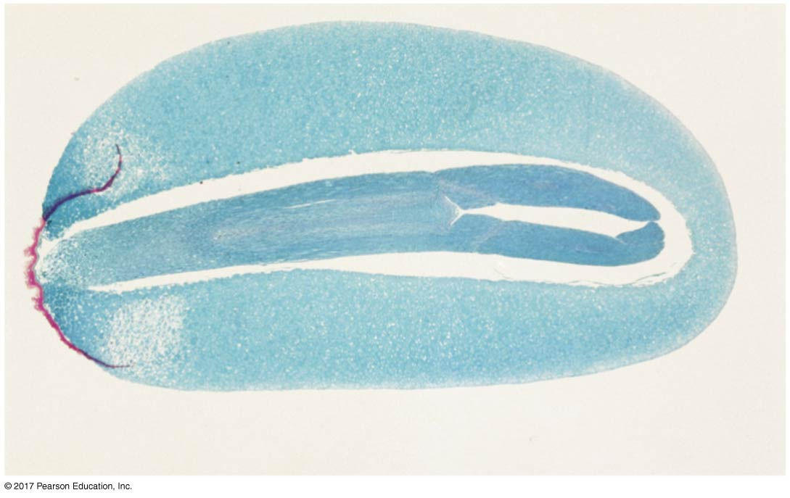
Figure 28.17
Embryo
Nutritive tissue
Protective coat
1 mm
© 2017 Pearson Education, Ltd.
Notes:
Figure 28.17 Seeds Contain an Embryo and a Food Supply and Can Be Dispersed.

Slide 59
Seeds
Life cycle of a pine tree—typical heterospory in gymnosperms:
Starting with the sporophyte on the left, note separate structures, called cones, where microsporangia and megasporangia develop
Microsporangia contain microspore mother cells that divide by meiosis to form microspores, which then divide by mitosis to form pollen grains
Megasporangia are found inside protective structures called ovules. Each megasporangium contains a megaspore mother cell that divides by meiosis to form a megaspore

Slide 60
Seeds
Life cycle of a pine tree—typical heterospory in gymnosperms:
Megaspore undergoes mitosis to form the female gametophyte, which then produces egg cells through further rounds of mitosis
The female gametophyte stays attached to the sporophyte as pollen grains arrive and produce sperm that fertilize the eggs
Seeds mature as the embryo develops. Inside the seed, cells derived from the female gametophyte become packed with nutrients provided by the sporophyte

Slide 61
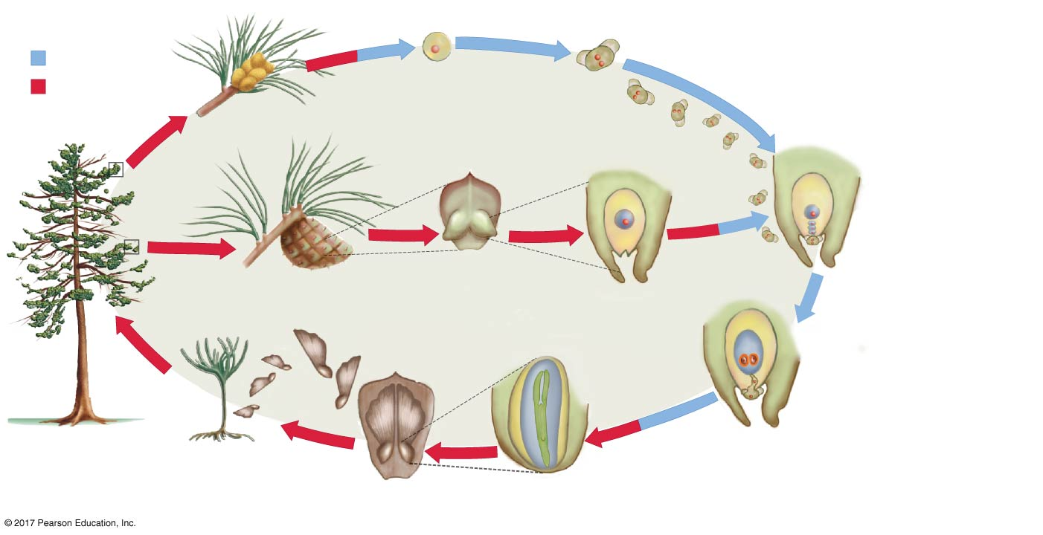
Figure 28.18
Pollen grains
disperse via wind
Haploid (n)
Microspore (n)
forms pollen grain
Diploid (2n)
Pollen grain
(male gametophyte)
Cones with
microsporangia
Four meiotic
products; one is
large and forms
the megaspore (n)
Megasporangium
Mother
cell (2n)
Three meiotic
products die
Pollen grain
Ovulate cone
Ovules (contain
megasporangia)
Female
gametophyte (n)
Embryo
Megaspore divides to
form female gametophyte (n),
which forms eggs by mitosis.
(Only one egg is fertilized
and develops.)
(2n)
Egg (n)
Pollen tube
Mature
sporophyte (2n)
Pollen tube
delivers sperm
to egg
Developing
sporophyte
Seeds (disperse
via wind or animals)
© 2017 Pearson Education, Ltd.
Notes:
Figure 28.18 Heterospory in Gymnosperms: Microspores Produce Pollen Grains; Megaspores Produce Female Gametophytes.

Slide 62
Flowers
Flowering plants, or angiosperms, are the most diverse land plants living today
About 350,000 species have been described, and more are discovered each year
Their success revolves around a reproductive organ—the flower
The stamen contains anther, where microsporangia develop
The carpel contains ovary where ovules are found
Ovules contain the megasporangia

Slide 63
Flowers
Double fertilization—angiosperm fertilization involves two sperm cells
One fuses with egg to form diploid (2n) zygote
One fuses with two nuclei in the female gametophyte to form a triploid (3n) nutritive tissue (endosperm)

Slide 64
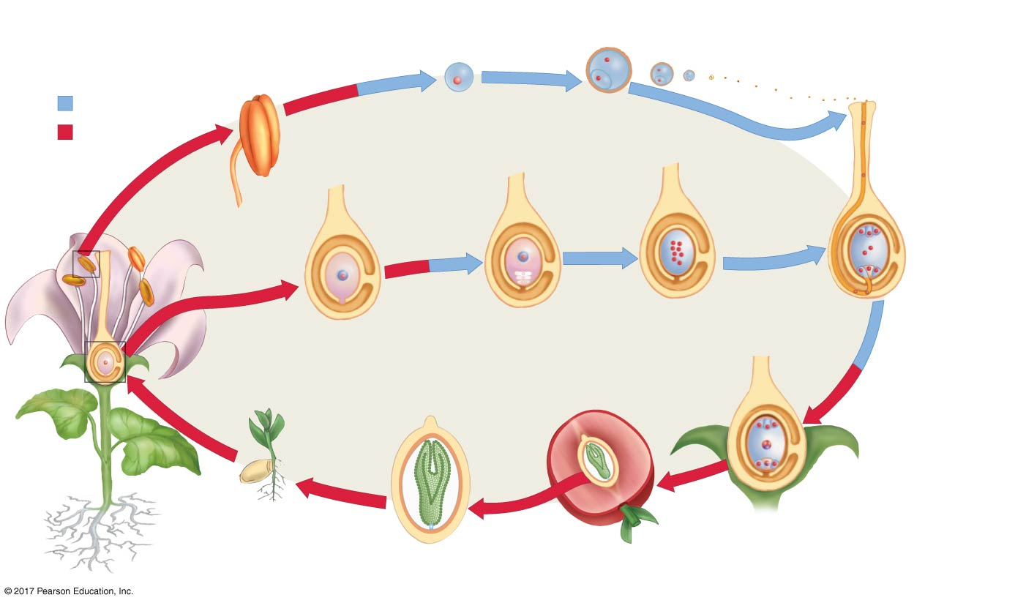
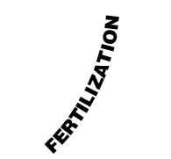
Figure 28.19
Pollen grains disperse
via wind or animals
Pollen lands
near female
gametophyte;
produces
pollen tube
and sperm
Haploid (n)
Microspore (n)
forms pollen grain
Pollen grain
(male
gametophyte)
Diploid (2n)
Anther
Sperm travel
down growing
pollen tube to
reach egg
Top of
stamen
Ovule
Ovary
Female gametophyte
(n: retained in ovary)
Egg (n)
Bottom of
carpel
Megaspore
(n: retained
in ovary)
Megasporangium
Endosperm (3n)
forms nutritive
tissue in seed
Embryo
(2n)
Mature
sporophyte
(2n)
Nutritive
tissue
(3n)
Zygote
(2n)
Developing
sporophyte
(2n)
Seed (disperses
via wind or animals)
Fruit (develops from ovary
wall) containing seed
© 2017 Pearson Education, Ltd.
Notes:
Figure 28.19 Heterospory in Angiosperms: Flowers Contain Microspores and Megaspores.

Slide 65
Pollination by Insects and Other Animals
After they evolved, stamens and carpels later became enclosed by modified leaves called sepals and petals
The four structures then diversified to produce a fantastic array of sizes, shapes, and colors
Specialized cells inside flowers also began producing a wide range of scents

Slide 66
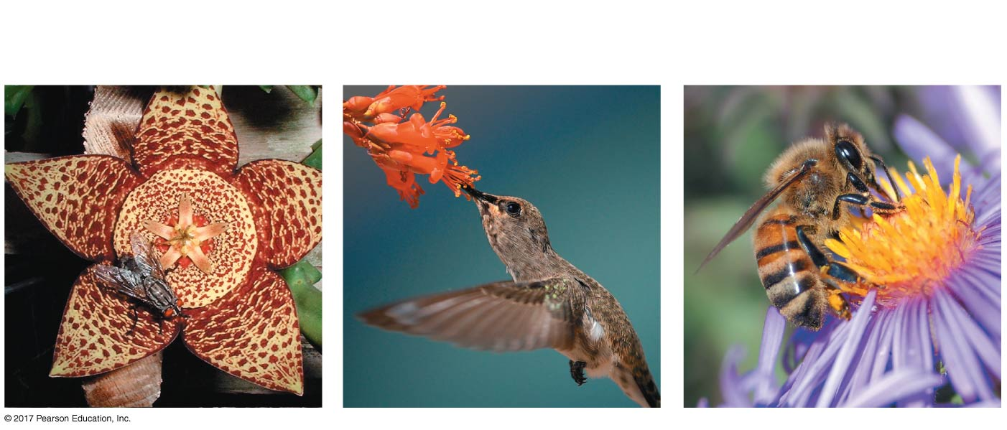
Figure 28.20
(a) Carrion flowers: Smell like
rotting flesh and attract carrion
flies
(b) Hummingbird-pollinated
flowers: Red, long tubes with
nectar at the base
(c) Bee-pollinated flowers:
Often bright purple
© 2017 Pearson Education, Ltd.
Notes:
Figure 28.20 Flowers with Different Scents, Shapes, and Colors Attract Different Pollinators.

Slide 67
Pollination by Insects and Other Animals
Flowers may be adaptations to increase the probability that an animal will perform pollination
The transfer of pollen from one individual’s stamen to another individual’s carpel
Biologists proposed the directed-pollination hypothesis:
Natural selection favored structures that reward an animal for carrying pollen directly from one flower to another
Flowers vary in size, structure, scent, and color in order to attract specific pollinators

Slide 68
Pollination by Insects and Other Animals
Flowers attract pollinators by providing them with food—either protein-rich pollen or nectar, a sugar-rich fluid
The relationship between flowering plants and their pollinators is mutually beneficial
The pollinator gets food, and the plant gets fertilized
Directed-pollination hypothesis has strong experimental support

Slide 69
Figure 28.21-2
Does flower color influence pollinator
preference?
Hawk moths prefer white petunias while bumblebees
prefer purple, even when the flowers are otherwise identical.
Neither insect has a clear preference for white-
or purple-flowered petunias.
1. Isolate AN2 gene for purple
flower color from a related
species (P. integrifolia) and insert
it into P. axillaris.
Wild-type
P. axillaris
Genetically altered
P. axillaris
2. Grow wild-type (white) and
genetically altered (purple)
P. axillaris in controlled
greenhouse conditions.
3. Count number of visits by
hawk moths and bumblebees to
white and purple flowers.
Notes:
Figure 28.21-2 The Adaptive Significance of Flower Color.

Slide 70
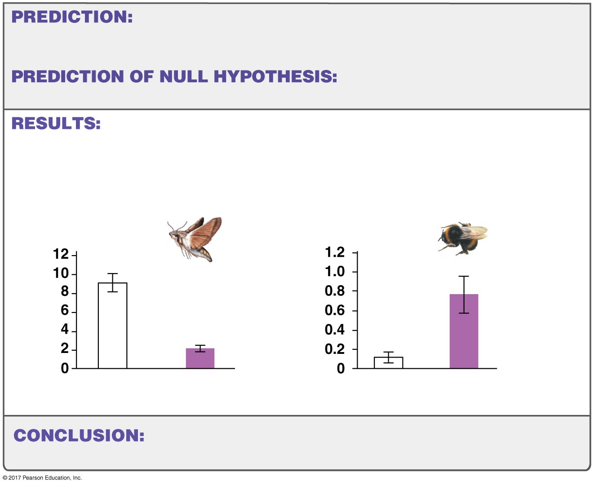
Figure 28.21-4
Hawk moths will visit white-flowered P. axillaris more
frequently, while bumblebees will visit purple-flowered P. axillaris
more frequently.
Both insects will visit white and
purple flowers equally.
Hawk moths visited white
flowers 4 times more
frequently than purple flowers
Bumblebees visited purple
flowers 7 times more
frequently than white flowers
Number of visits per
flower per period (5 min)
Number of visits per
flower per period (2 hrs)
Wild type
Genetically
altered
Wild type
Genetically
altered
Petunia flower preference among bumblebees and
hawk moths is significantly influenced by flower color.
Notes:
Figure 28.21-4 The Adaptive Significance of Flower Color.

Slide 71
Pollination by Insects and Other Animals
The spectacular diversity of angiosperms resulted from coevolution with animal pollinators
Evolutionary changes in angiosperms and corresponding changes in their pollinators were highly dependent on each other
Many animals and the flowering plants they pollinate depend on each other for their survival

Slide 72
Fruits
A fruit is a structure that is derived from the ovary and encloses one or more seeds
Tissues derived from the ovary are often nutritious and brightly colored
While the evolution of flowers made efficient pollination possible, the evolution of fruit made efficient seed dispersal possible

Slide 73
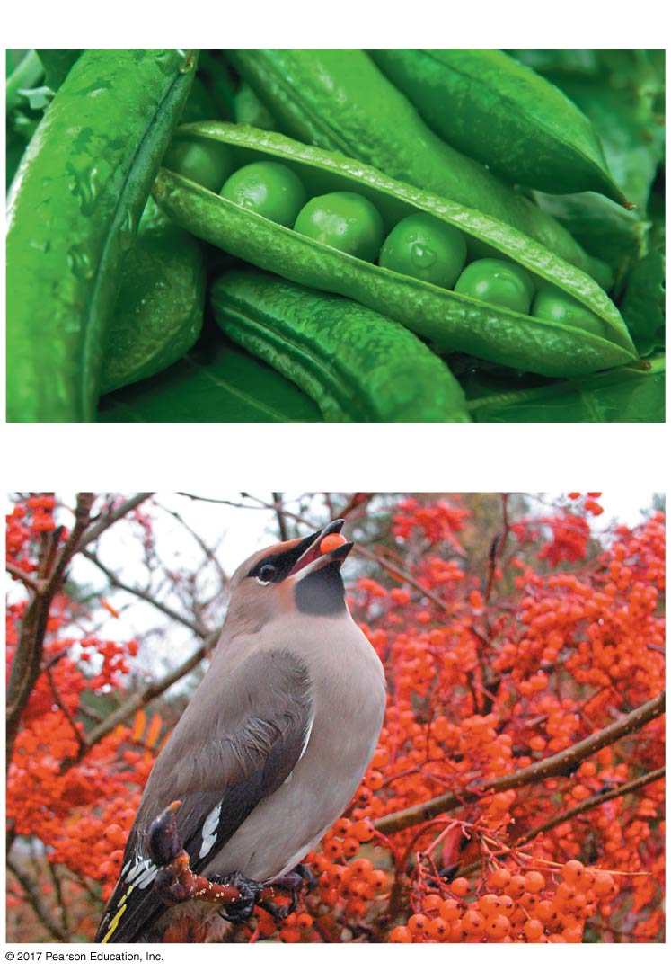
Figure 28.22
(a) Fruits are derived from ovaries and contain seeds.
Wall of
ovary
Seed
(b) Many fruits are dispersed by animals.
© 2017 Pearson Education, Ltd.
Notes:
Figure 28.22 Fruits Are Derived from Ovaries Found in Angiosperms.

Slide 74
The Angiosperm Radiation
An adaptive radiation occurs when a single lineage produces a large number of descendant species that are adapted to a wide variety of habitats
Angiosperms represent one of the great adaptive radiations in the history of life

Slide 75
The Angiosperm Radiation
The diversification of angiosperms is associated with three key adaptations:
Water-conducting vessels
Flowers
Fruits
These adaptations allow angiosperms to transport water, pollen, and seeds efficiently

Slide 76
The Angiosperm Radiation
On the basis of morphological traits, angiosperms have traditionally been divided into two major groups:
​​Monocotyledons (monocots)
​Dicotyledons (dicots)
The groups are divided based on differences in their cotyledons, or first leaves
Cotyledons store nutrients and provide them to the embryo
Monocots have one cotyledon
Dicots have two cotyledons

Slide 77
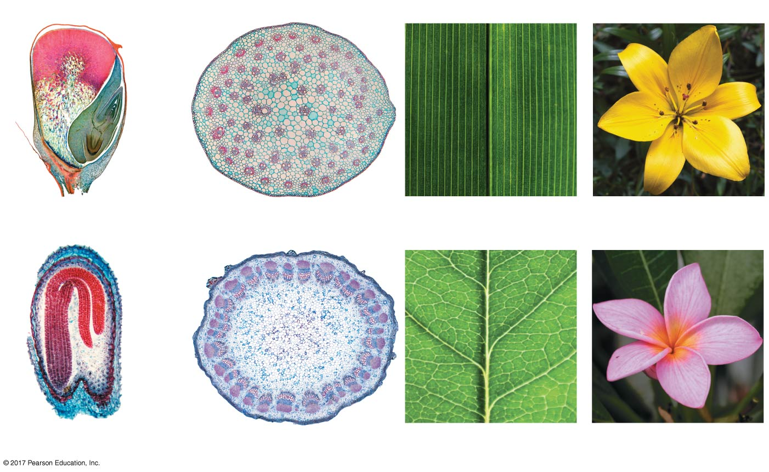
Figure 28.24
Cotyledons
Vascular tissue
Veins
Flowers
MONOCOTS
Cotyledon
One cotyledon
(corn embryo)
Vascular tissue scattered
throughout stem
Parallel veins in leaves
(bundles of vascular tissue)
Petals in multiples of 3
DICOTS
Cotyledons
Two cotyledons
(mustard embryo)
Vascular tissue in circular
arrangement in stem
Branching veins in leaves
Petals in multiples of 4 or 5
© 2017 Pearson Education, Ltd.
Notes:
Figure 28.24 Four Morphological Differences between Monocots and Dicots.

Slide 78
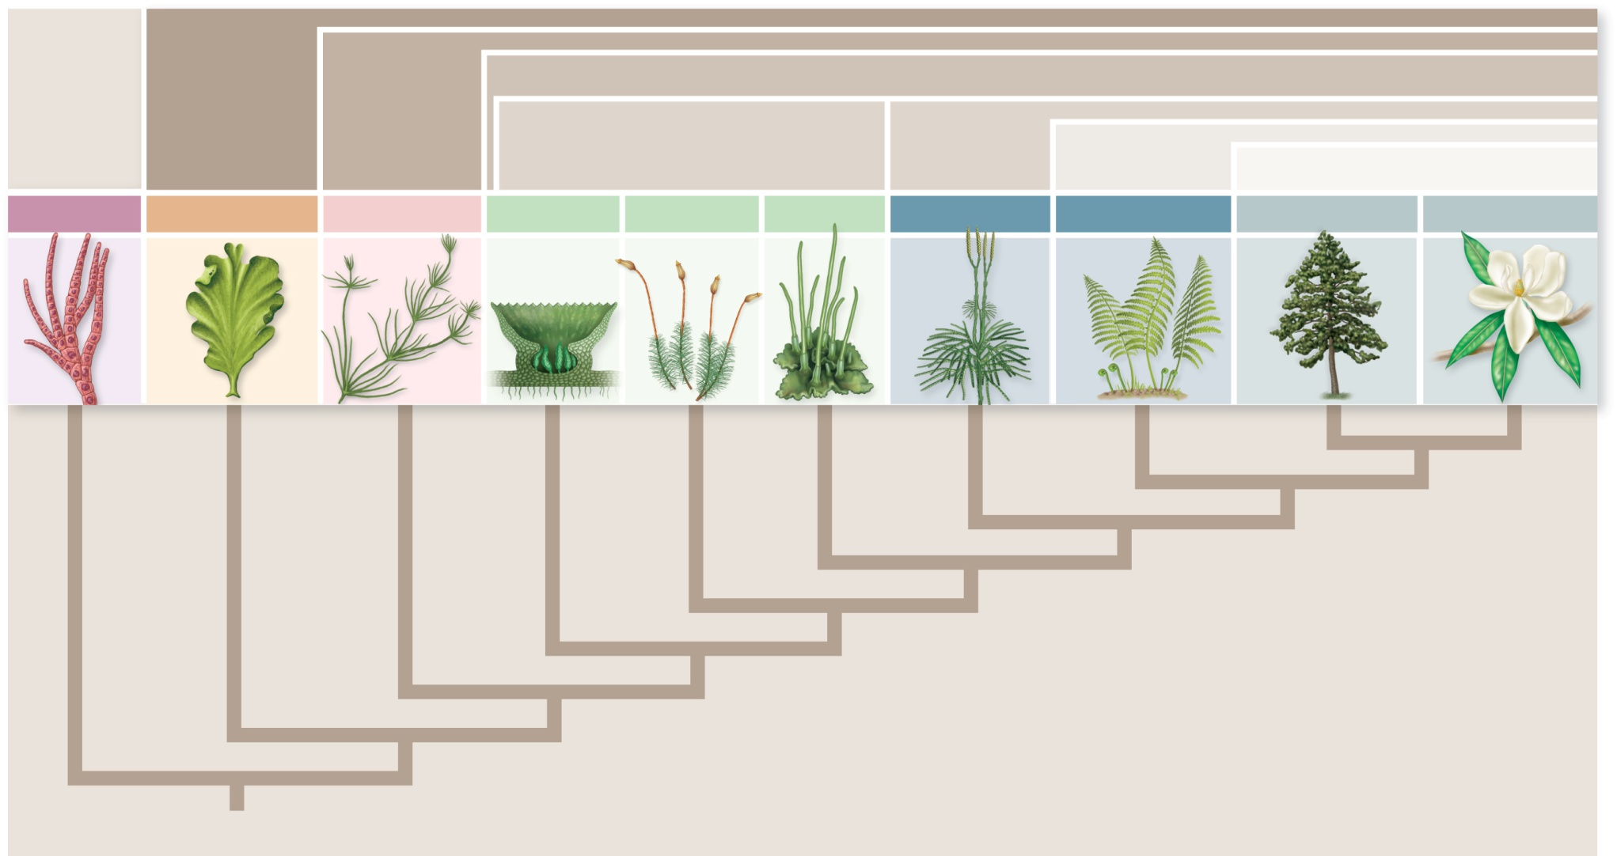
Copyright © The McGraw-Hill Companies, Inc. Permission required for reproduction or display.
Green plants
Streptophyta
Land plants
Bryophytes
Tracheophytes
Euphyllophytes
Green algae
Green algae
Seed plants
Red Algae
Chlorophytes
Charophytes
Liverworts
Mosses
Hornworts
Lycophytes
Ferns + Allies
Gymnosperms
Angiosperms
Ancestral alga

Slide 79
Nonvascular Plants
Nonvascular plants
Gametophyte is dominant and longer-lived phase of life cycle
Individuals anchored to soil, rocks, or tree bark by rhizoids
Lack vascular tissue with lignin-reinforced cell walls
Flagellated sperm that swim to eggs
Spores dispersed by wind

Slide 80
Table 28.3
© 2017 Pearson Education, Ltd.
Notes:
Table 28.3 Key Lineages of Nonvascular Plants.

Slide 81
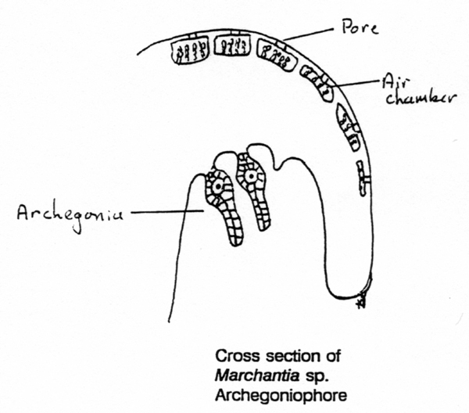
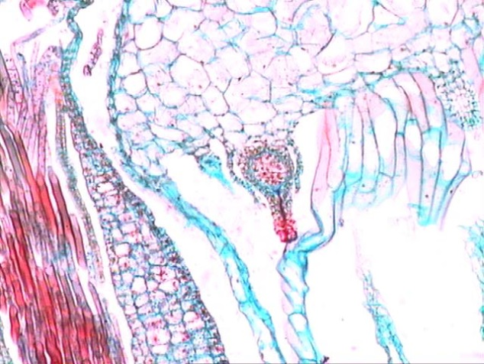
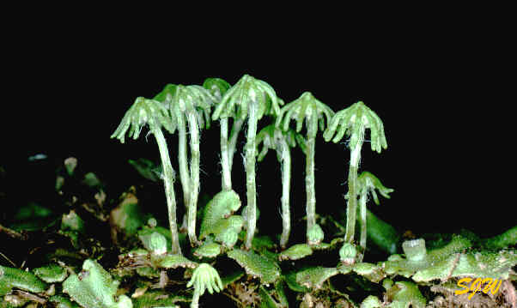
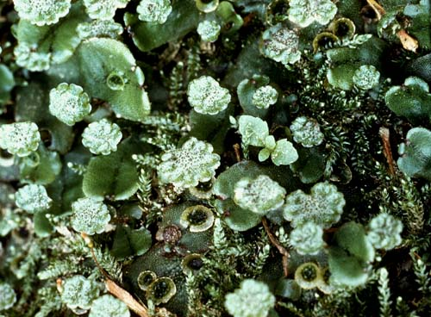
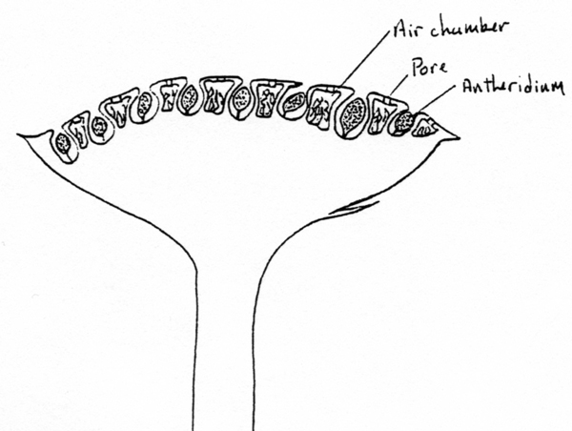
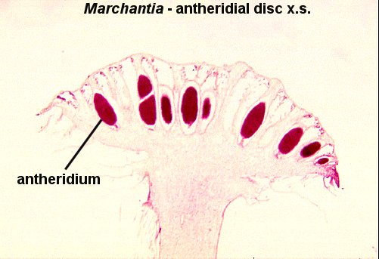

Slide 82
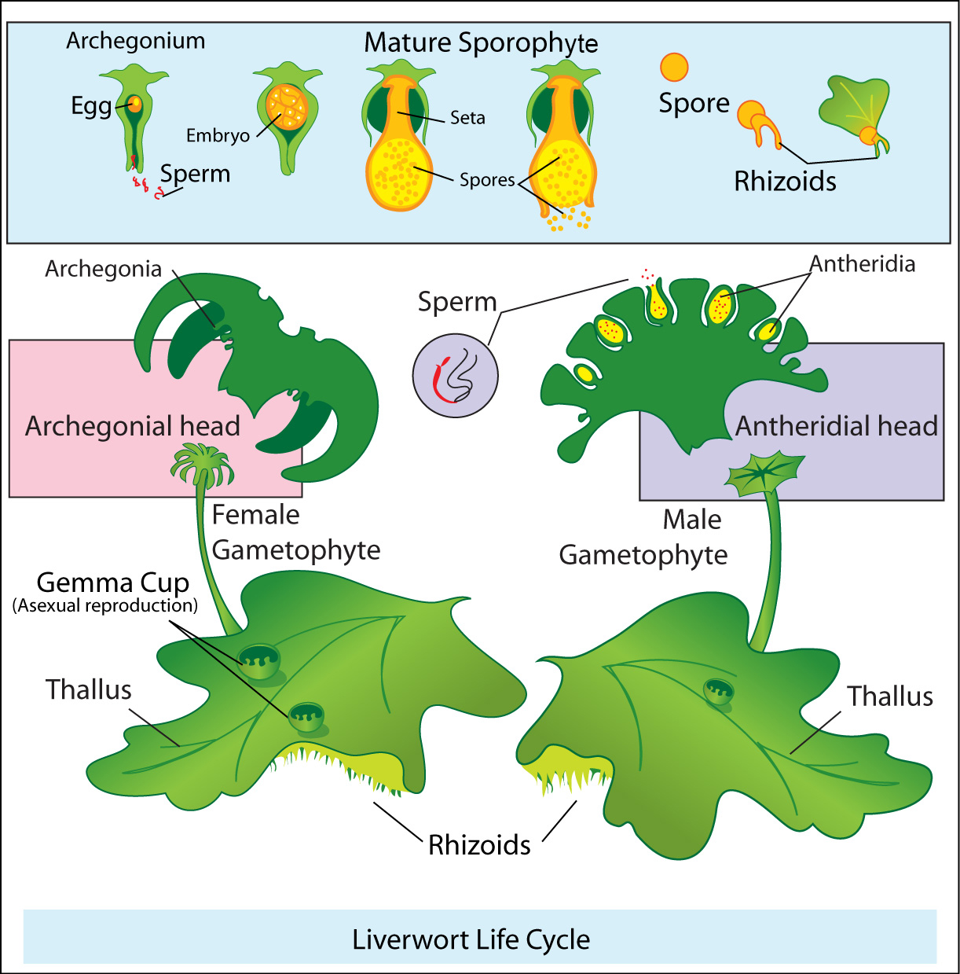

Slide 83
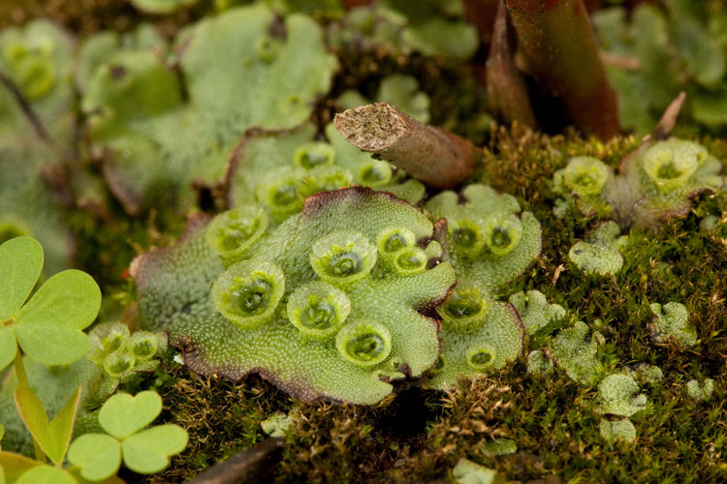
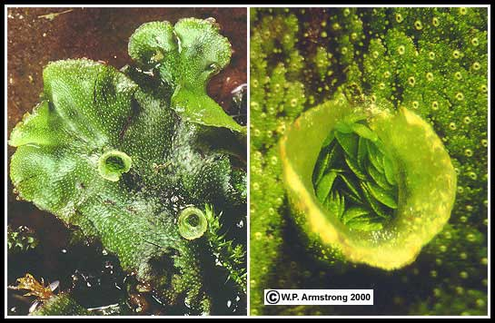
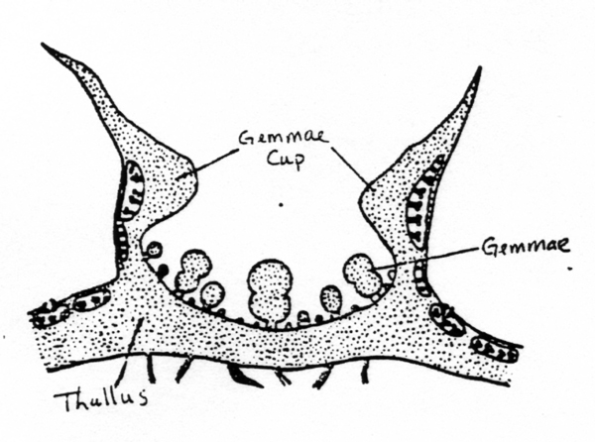

Slide 84
Table 28.3
© 2017 Pearson Education, Ltd.
Notes:
Table 28.3 Key Lineages of Nonvascular Plants.

Slide 85
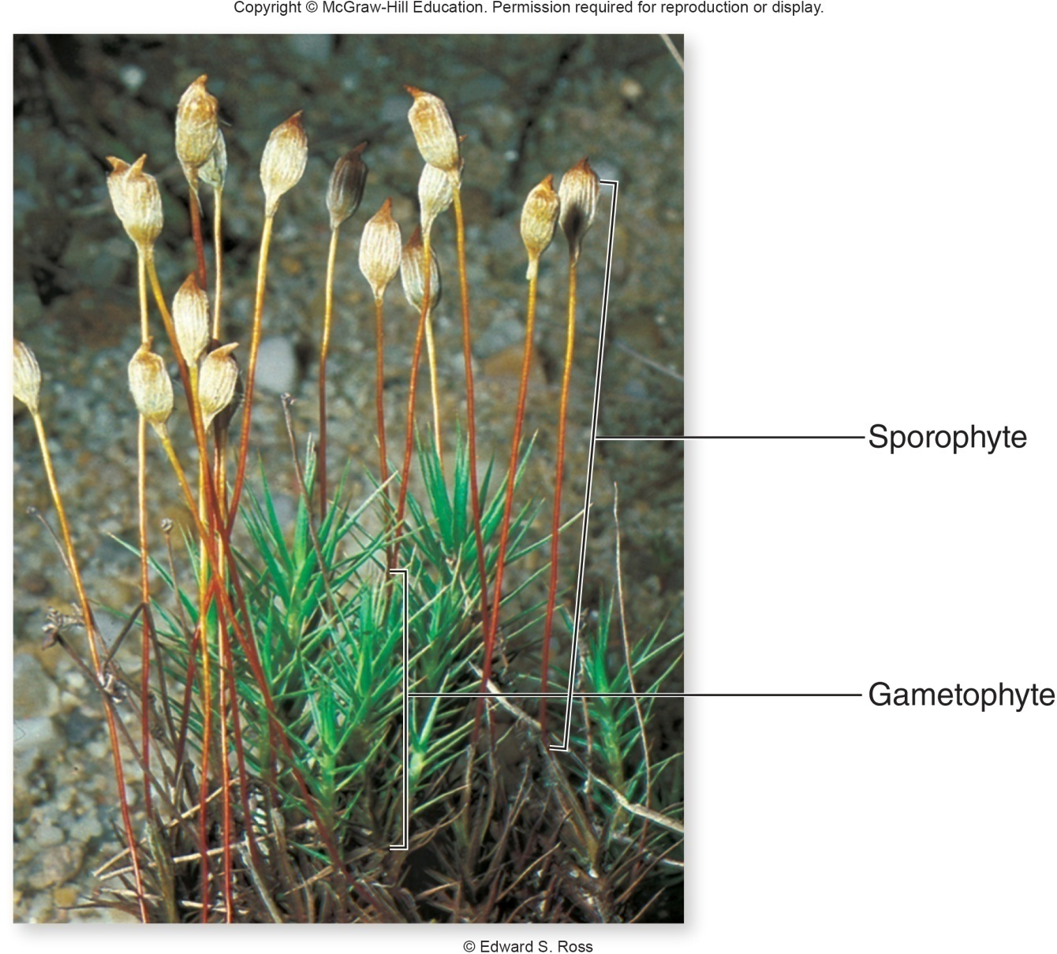
Figure 30.4
Jump to long image description

Slide 86
Table 28.3
© 2017 Pearson Education, Ltd.
Notes:
Table 28.3 Key Lineages of Nonvascular Plants.

Slide 87
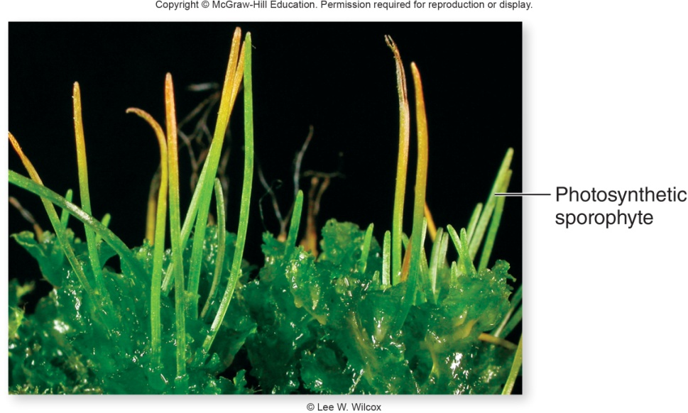
Hornworts (phylum Anthocerotophyta)

Slide 88
Seedless Vascular Plants
Vascular tissue comprised of lignin-reinforced cells
Sporophyte dominant, longer-lived phase of life cycle
But, gametophyte physically independent of sporophyte
Eggs retained on gametophyte, and sperm swim to egg with flagella
Sporophytes develop on gametophyte and are nourished by gametophyte when small

Slide 89
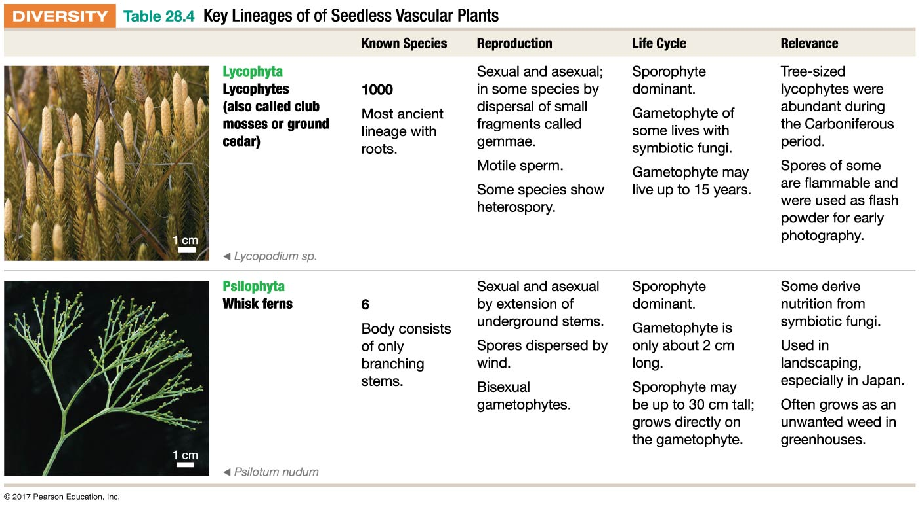
Table 28.4-1
© 2017 Pearson Education, Ltd.
Notes:
Table 28.4-1 Key Lineages of Seedless Vascular Plants.

Slide 90
Table 28.4-1
© 2017 Pearson Education, Ltd.
Notes:
Table 28.4-1 Key Lineages of Seedless Vascular Plants.

Slide 91
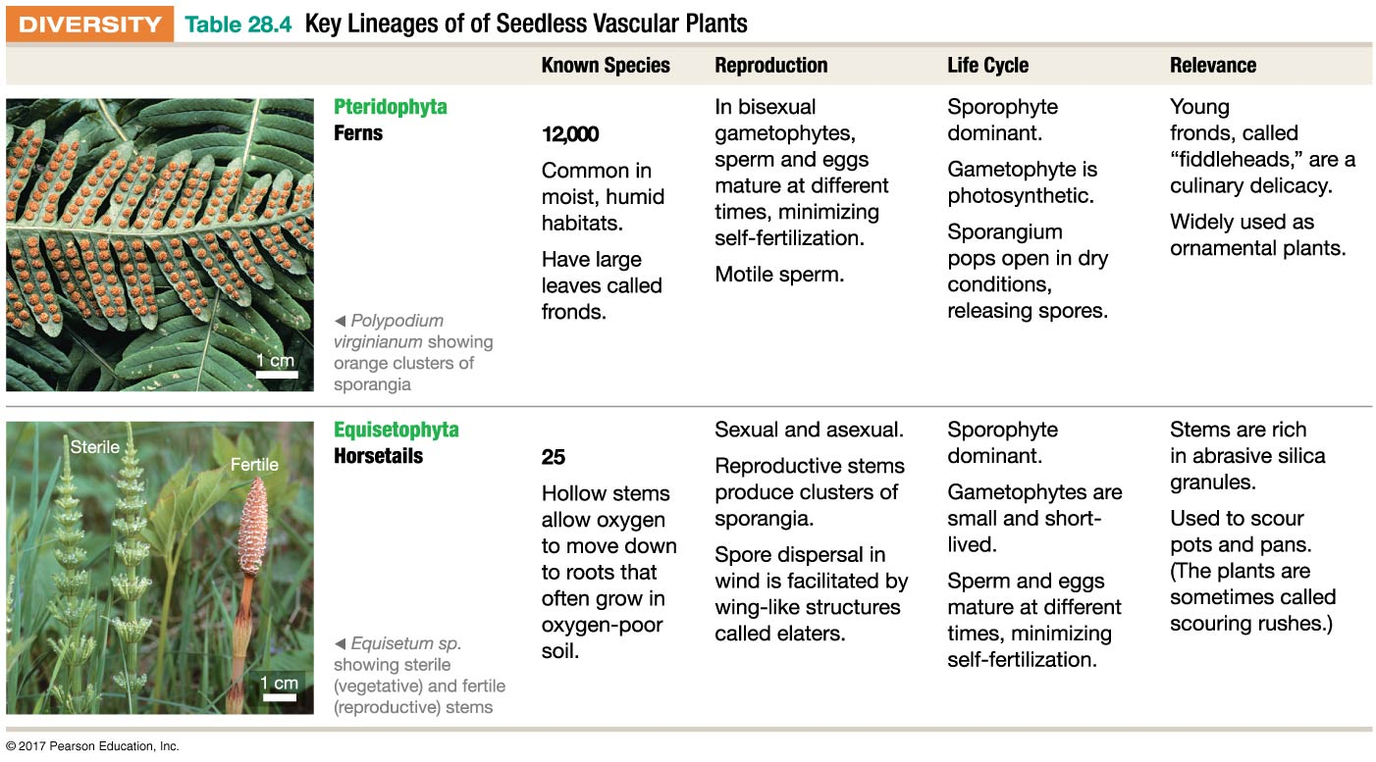
Table 28.4-2
© 2017 Pearson Education, Ltd.
Notes:
Table 28.4-2 Key Lineages of Seedless Vascular Plants.

Slide 92
Table 28.4-2
© 2017 Pearson Education, Ltd.
Notes:
Table 28.4-2 Key Lineages of Seedless Vascular Plants.

Slide 93
Seed Plants: Gymnosperms and Angiosperms
Seed plants
Include gymnosperms and the angiosperms
Production of seeds
Production of pollen grains
Angiosperms produce seeds in ovaries, gymnosperms do not

Slide 94
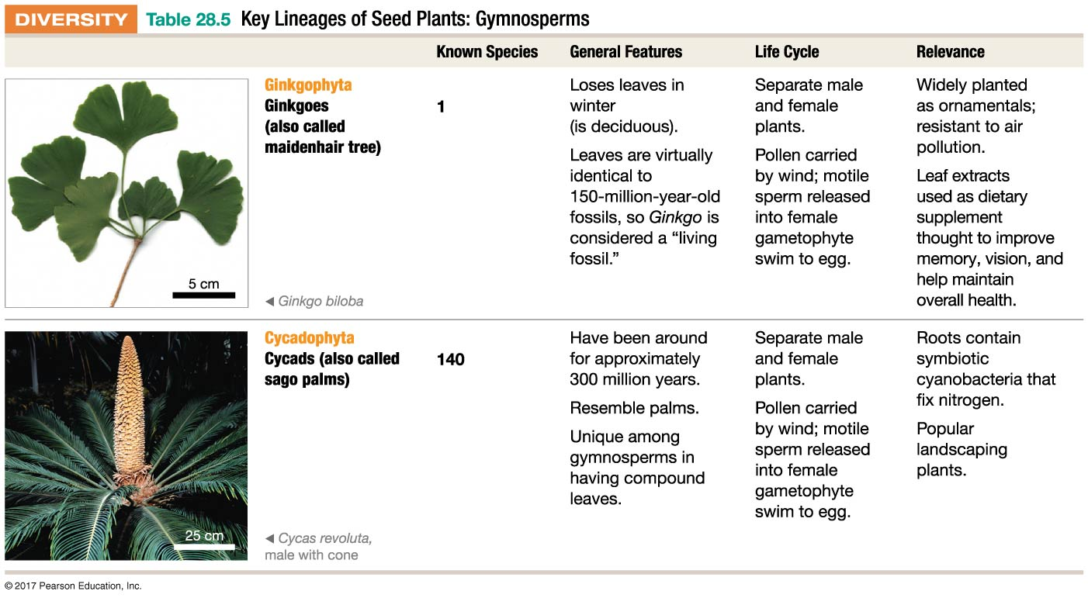
Table 28.5-1
© 2017 Pearson Education, Ltd.
Notes:
Table 28.5-1 Key Lineages of Seed Plants: Gymnosperms.

Slide 95
Table 28.5-1
© 2017 Pearson Education, Ltd.
Notes:
Table 28.5-1 Key Lineages of Seed Plants: Gymnosperms.

Slide 96
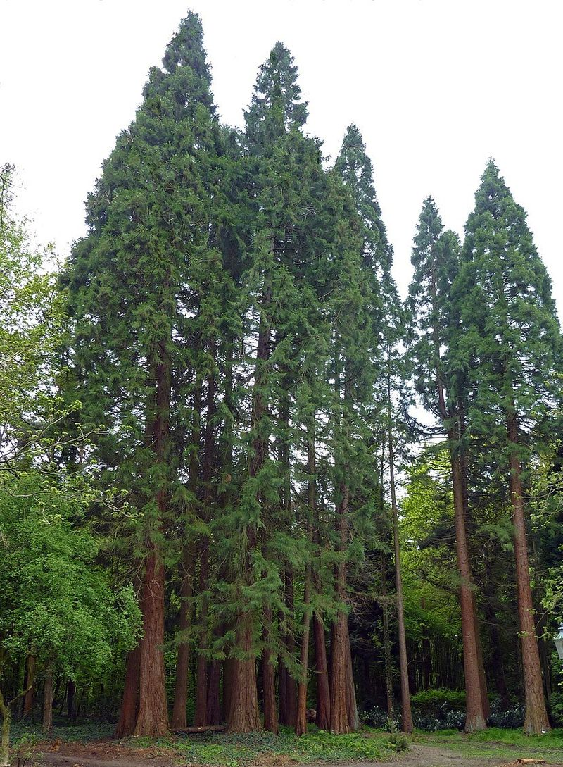
Table 28.5-2
rewood
© 2017 Pearson Education, Ltd.
Notes:
Table 28.5-2 Key Lineages of Seed Plants: Gymnosperms.

Slide 97
Table 28.5-2
© 2017 Pearson Education, Ltd.
Notes:
Table 28.5-2 Key Lineages of Seed Plants: Gymnosperms.

Slide 98
Table 28.5-2
© 2017 Pearson Education, Ltd.
Notes:
Table 28.5-2 Key Lineages of Seed Plants: Gymnosperms.

Slide 99
Table 28.6-1
© 2017 Pearson Education, Ltd.
Notes:
Table 28.6-1 Key Lineages of Seed Plants: Angiosperms.

Slide 100
Table 28.6-2
© 2017 Pearson Education, Ltd.
Notes:
Table 28.6-2 Key Lineages of Seed Plants: Angiosperms.

